Slide 1

AI-Powered Real-Time Theft Detection System for Shopping Malls
Group Members
Muhammad Nadeem(22P-9366)
Laiba Shahi(22P-9247)
Sultan Mehmood Mughal(22P-9242)
Project Supervisor
Dr.Hafeez Anwar

Slide 2
Introduction
Shoplifting: Causes heavy financial loss for malls.
Manual CCTV monitoring: Slow, high chances of error, thief may escape.
Need: Real-time, automated multi-camera theft detection.
Value: High security, reduced financial losses, timely alerts for staff.

Slide 3
Motivation
Looking for a real-world problem
Visit to Inspire Mall
Insight: “We have CCTV cameras, but by the time we notice theft in footage, the thief has already left.”
Delayed Response: Security reacts slowly
Inefficient Monitoring: Human errors occur
Increased Operational Cost: More staff needed
Revenue Loss: Shops lose profit
No Real-Time Tracking: Thieves go unseen

Slide 4
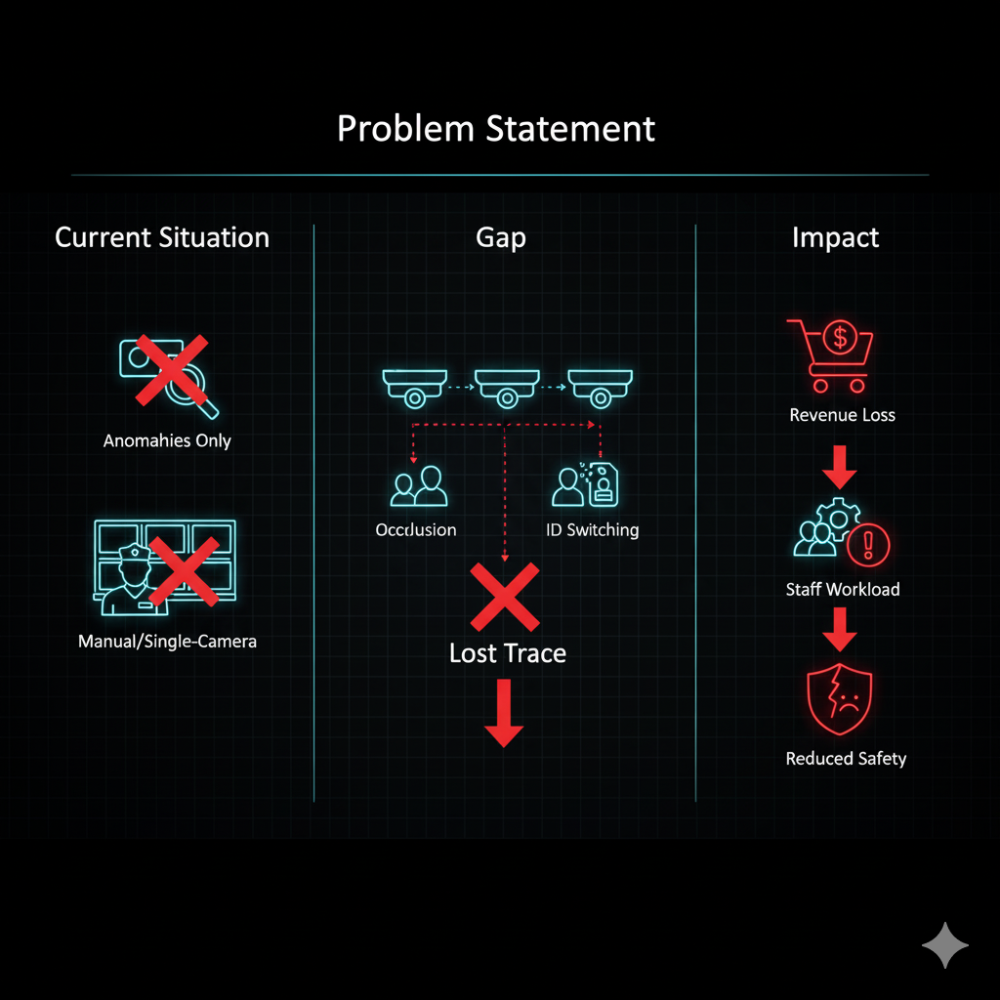
Problem Statement
Current Situation: CCTV in malls is manual/single-camera; existing systems detect anomalies only.
Gap: No continuous customer tracking across cameras → occlusion,
ID switching, lost trace.
Impact: Higher theft risk, revenue loss, extra staff workload, reduced safety.
Scope: FYP aims to design an AI-based multi-camera customer tracking system for malls.

Slide 5
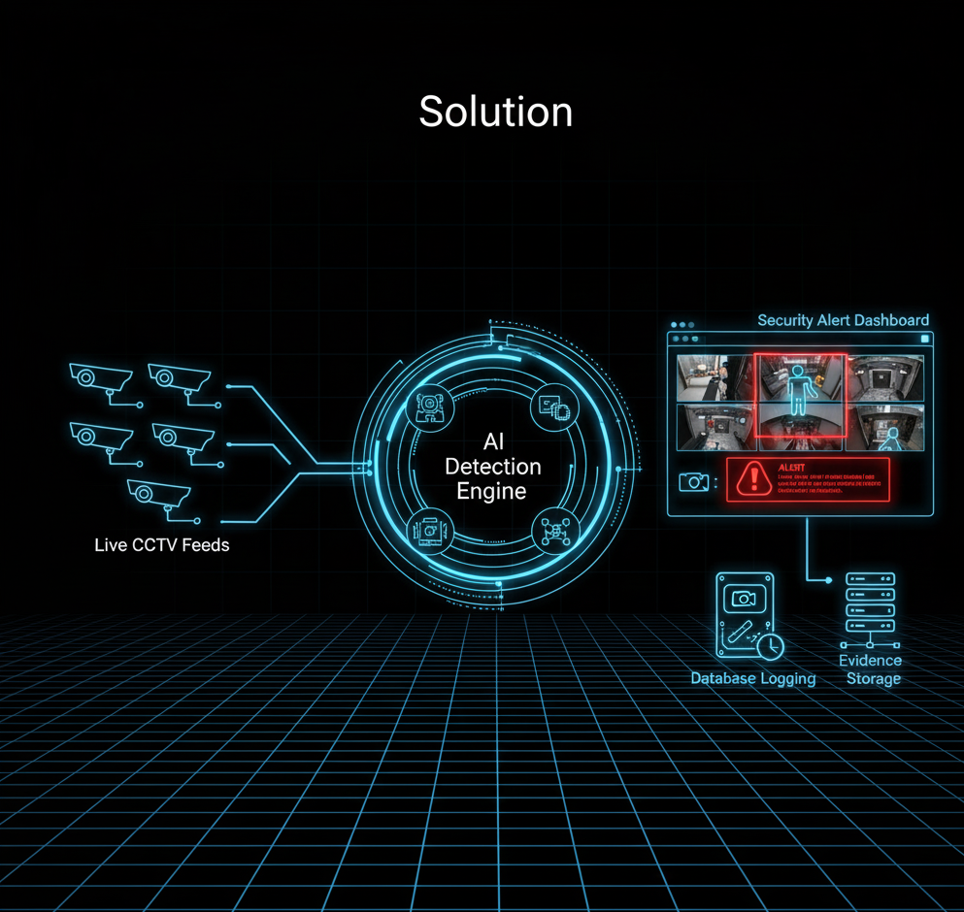
Solution
We propose to develop an AI-powered real-time theft detection system that enhances existing CCTV cameras by making them intelligent. The system will:
Recognize suspicious actions
Send instant alerts to security guards.
Store evidence (screenshots, timestamps) in a database for later use.

Slide 6
Solution continuation…
Key Solution Components
Computer Vision: For object and human movement detection.
Deep Learning: AI model training to recognize suspicious patterns.
Action Recognition: Identifying specific theft-related actions.
Alert Dashboard: Web-based interface for mall security staff.
Database Logging: Secure storage of theft incidents for reporting and analysis.

Slide 7
Scope of the project
Covered in project:
Data collection and preprocessing.
AI model training (object + action recognition).
Real-time video analysis.
Dashboard with alerts.
Database logging.

Slide 8
Goals
Design a system to automatically detect theft.
Provide a cost-effective alternative.
Reduce human dependency on continuous CCTV monitoring.
Create a system capable of real-time detection using live video streams.
Increase security efficiency by providing instant alerts of suspicious activities.
Contribute towards loss prevention for malls ,hence improving business profit.

Slide 9
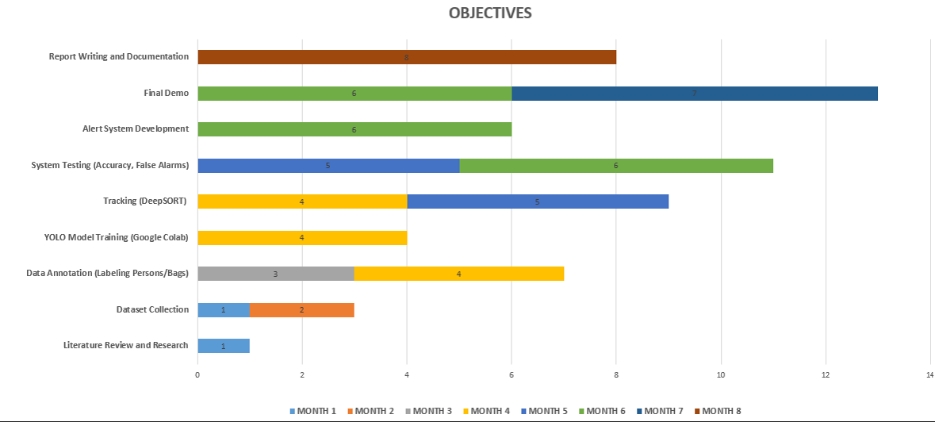
Objectives

Slide 10
Expected Result
A working system that can analyze CCTV footage.
Detection of people in the video stream.
Reliable tracking of individuals.
Identifying suspicious behaviors.
Alert system for notifying security staff.
Reduce reliance on manual monitoring, minimizing human error.
Scalable solution that can be extended to multiple cameras and larger retail stores.
A foundation for future improvements.

Slide 11
Work Distribution
Name | Roll | Contribution
Sultan mehmood Mughal | 22p-9242 | Data collection , Data preprocessing , literature review
Muhammad Nadeem | 22p-9366 | Model Selection, literature review
Laiba Shahi | 22p-9247 | UI, comparison with other Models, literature review

Slide 12
Thank You

